Slide 1
Updated NLA Prototypes
Prepared by Mike Crow
Supporting 2014-09-26 Meeting

Slide 2
Caveats
Dummy data used. There may be inconsistencies in data within and across charts. Do not draw conclusions.
Many formatting aspects can be improved/adjusted. Formatting focus has been on data marks (i.e., bars/dots).

Slide 3
National Summary Prototypes
NOTES
Dashboards with 3 different charts each
Alignment/layout can be improved
Same model could be adapted to show breakout by eco-regions for a single measure, and breakout of measures for a single eco-region (with or without national reference lines)
Trying to reserve dark color solely for indication of statistically significant differences

Slide 4
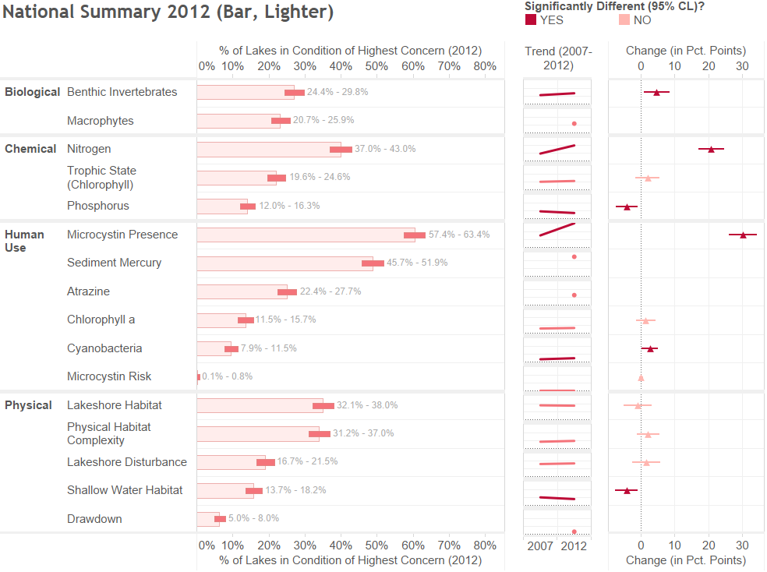

Slide 5
Variations on Point Estimate Charts
Drill down bar chart with good/fair/poor conditions (could develop something similar with dot plots instead of bars)
Single eco-region, with reference ranges for national confidence intervals
Single metric, with multiple eco-regions and reference ranges for national confidence intervals
New version of eco-region/metrics matrix (by size instead of heat map coloring)

Slide 6
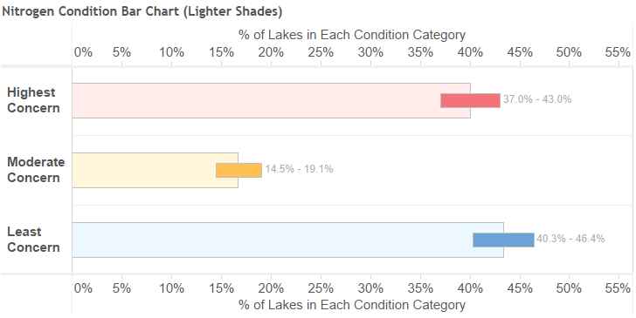
Drilling in on a Particular Measure

Slide 7
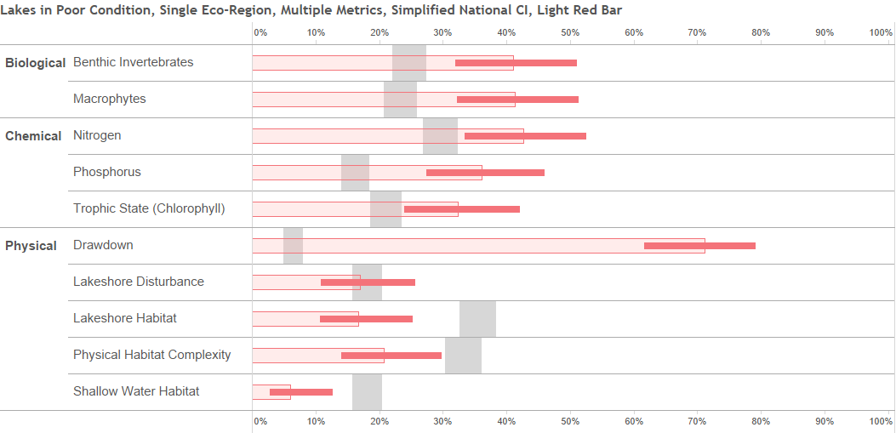
NOTES
Gray bars indicate national confidence interval. Trying to avoid similarity with box plots.
– Note that Human Use measures are filtered out of this view.

Slide 8
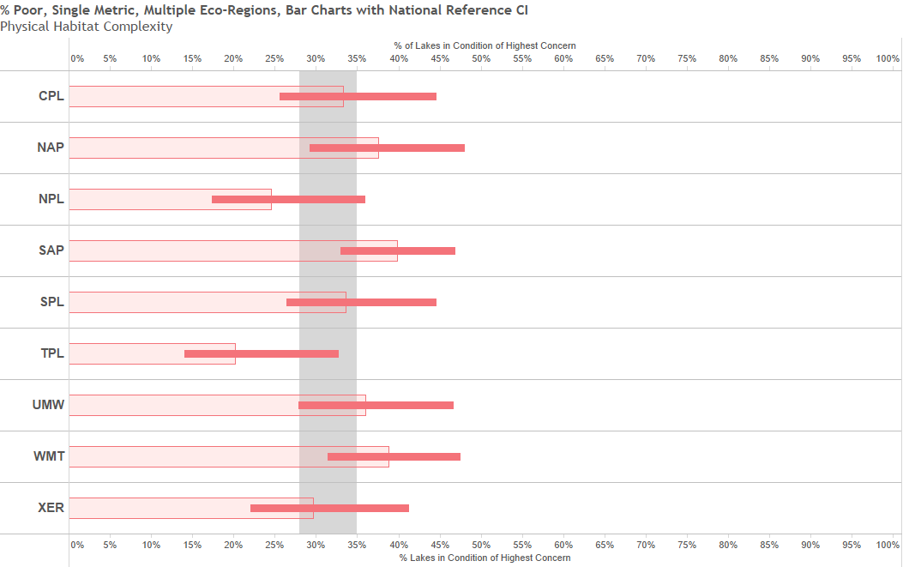
NOTES
Gray bars indicate national confidence interval. Trying to avoid similarity with box plots.
– one issue to consider would be variations in types of eco-regions. Should there be consistency or not? Bear in mind that box plots probably work best with the region type used to calculate good/fair/poor thresholds.
Notes:
Issue national with confidence intervals: need to be careful not to confuse users with similarity to box plots.
Also, consider whether it’s worth it. I.e., whether the visual noise is worth the occasional(?) identification of an apparent significant difference
Alternate approach could be to show eco-region breakout along with the standard bar for the national result. Should reduce confusion

Slide 9
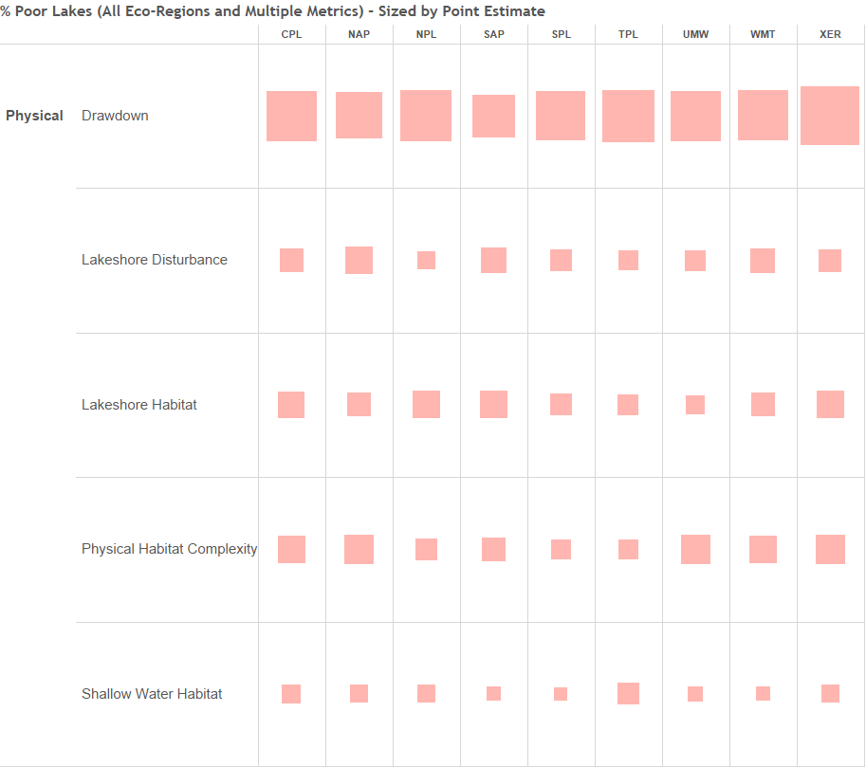
NOTES
Notes:
Using size and set of color intensity, which is reserved for statistical significance. Still seems to work at a scale with more measures.
Might be possible to have a combination of squares showing confidence interval. Not sure it can be done easily and not sure it will display well.

Slide 10
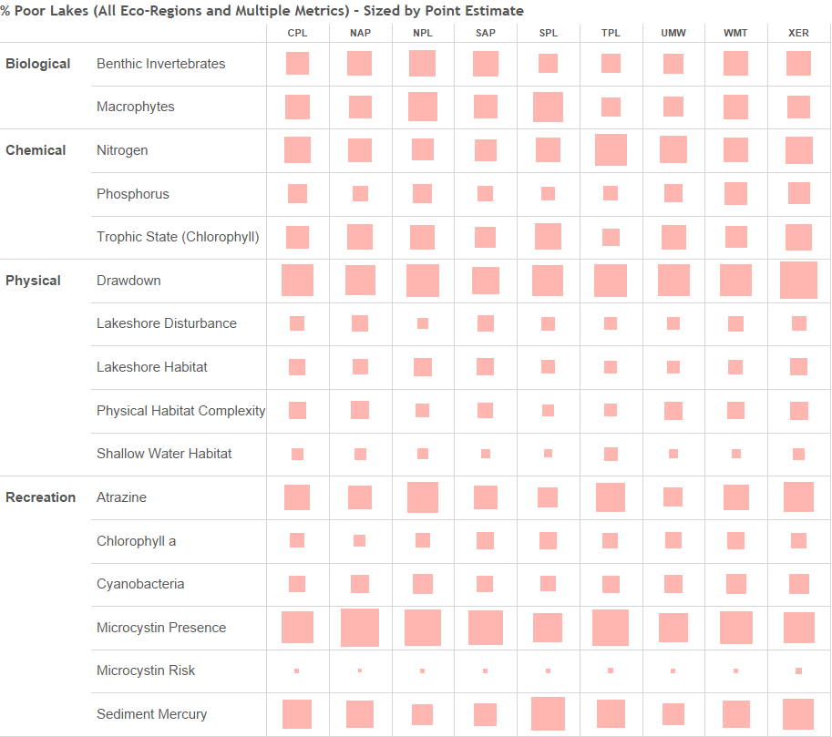

Slide 11
Regional Box Plots for a Single Metric
Different types of measures have different kinds of reference ranges (some are nationally consistent while many aren’t, most have thresholds on the upper end of the scale rather than the lower)
Poor/fair color intended to be similar to those used in other graphics.
Outliers in some cases create scaling issues, smooshing the box plots. Options include logarithmic scaling or not showing dots.

Slide 12
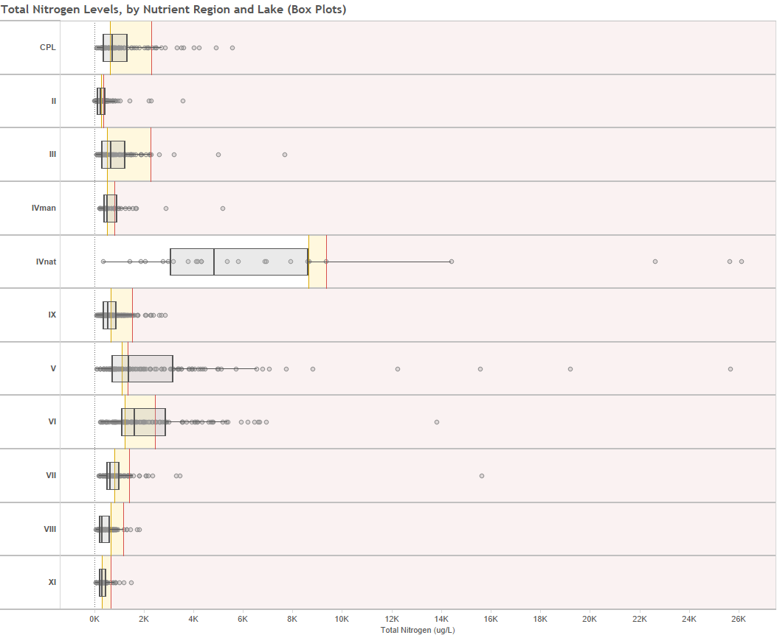
NOTES

Slide 13
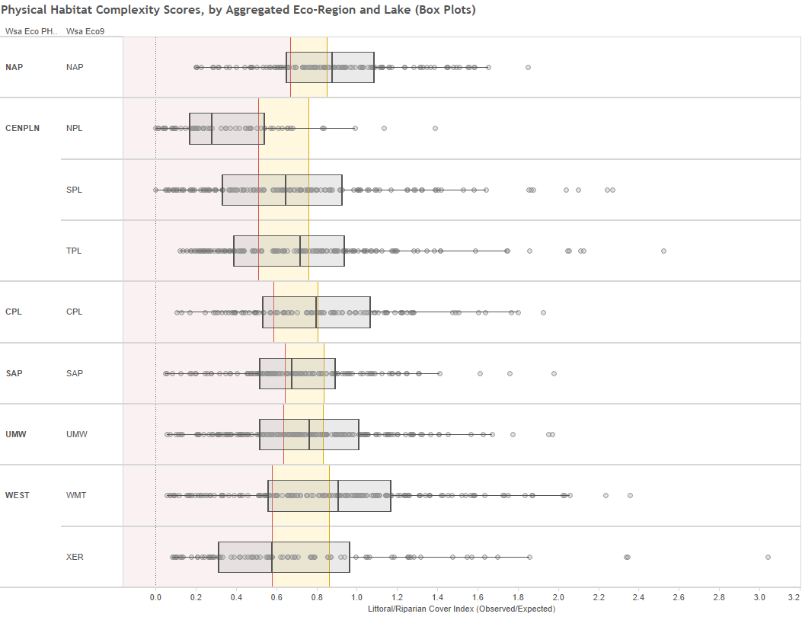

Slide 14
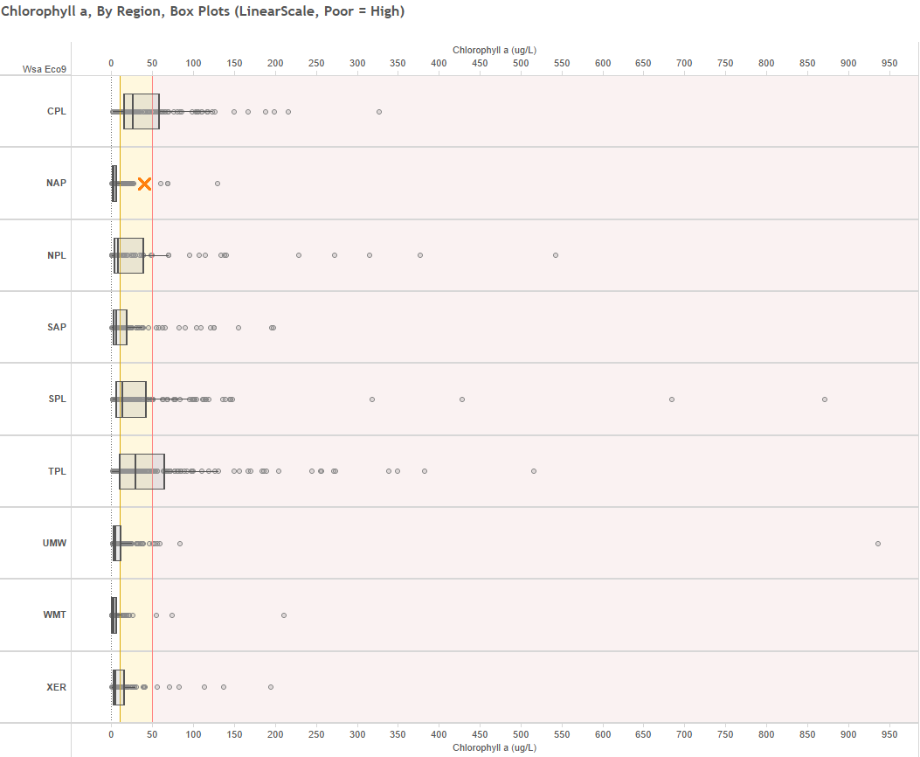

Slide 15
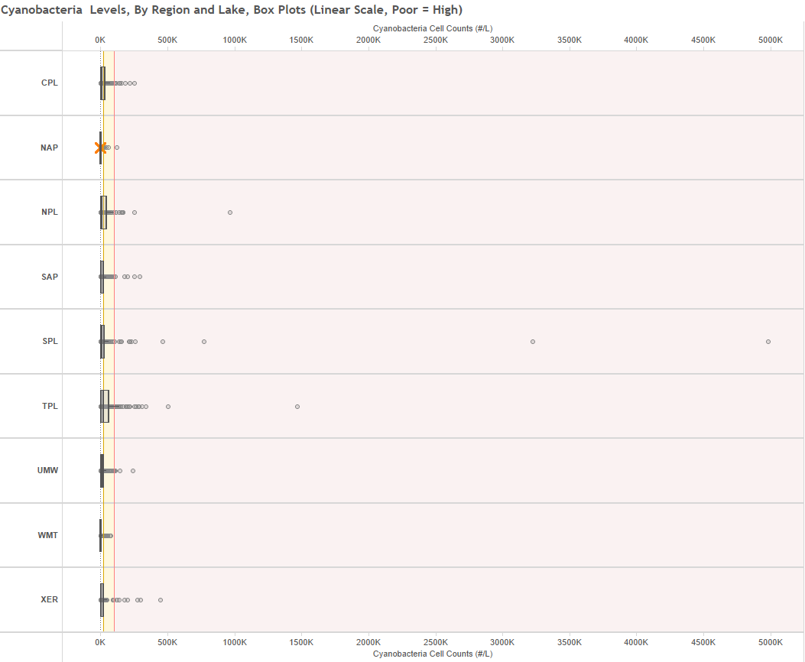

Slide 16
